Slide 1
5S Assignment
Nathan Kistler

Slide 2
Sort
Determine the high-level locations objects should go
Bike Tools
Bike Consumables
General Purpose Tools
Bike Spare Parts
General Purpose Spare Parts
Trash
Physically sort between the objects between the drawers

Slide 3
Straighten
Put tools and supplies in a logical location
Bike supply consumable and tool drawers
Put supplies in order of application to bike
Tire supplies go with tire supplies, drivetrain with drive train, etc.
General purpose tools
Put like supplies with each other
Fasteners with fasteners, hammers with hammers, etc.

Slide 4
Clean
Remove all materials from their store-bought packaging
Throw all materials away that would not be used for the next year

Slide 5
Standardize
Set weekly reminder to check status of the toolchest and make sure everything is in it’s defined location
Ensure all household members know of the proper location for everything in the toolchest

Slide 6
Sustain
Check weekly to ensure everything is in its predefined location
Set semi-yearly reminder to check and make sure the defined spots are still logical in case any new tools have come into the rotation and are necessary
Evaluate semi-yearly to ensure the size of the toolchest is still appropriate. That is – the 5S principles do not need to be extended to remaining drawers

Slide 7
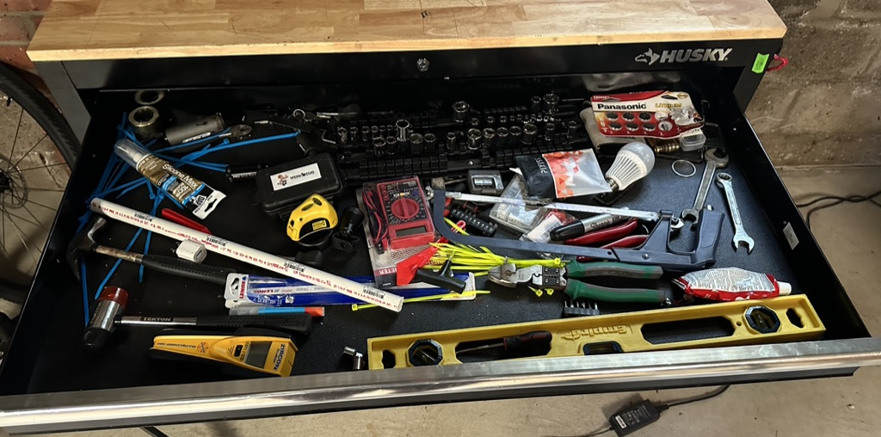
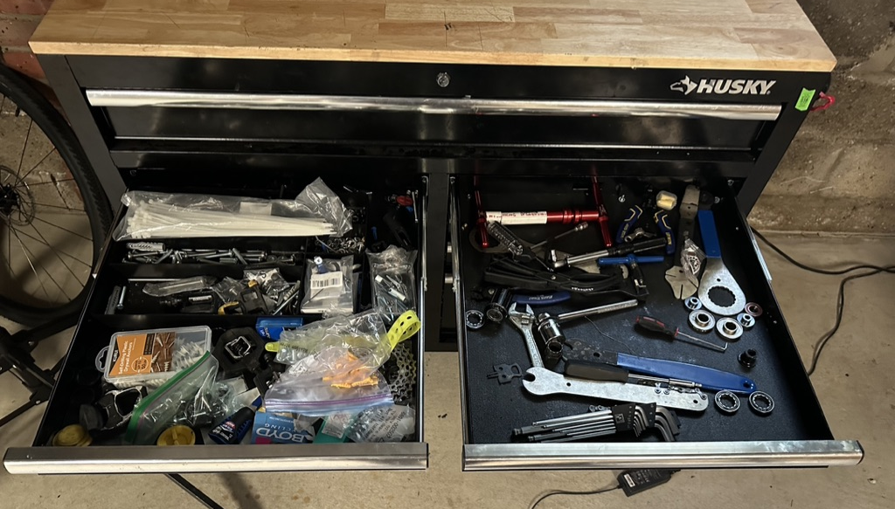
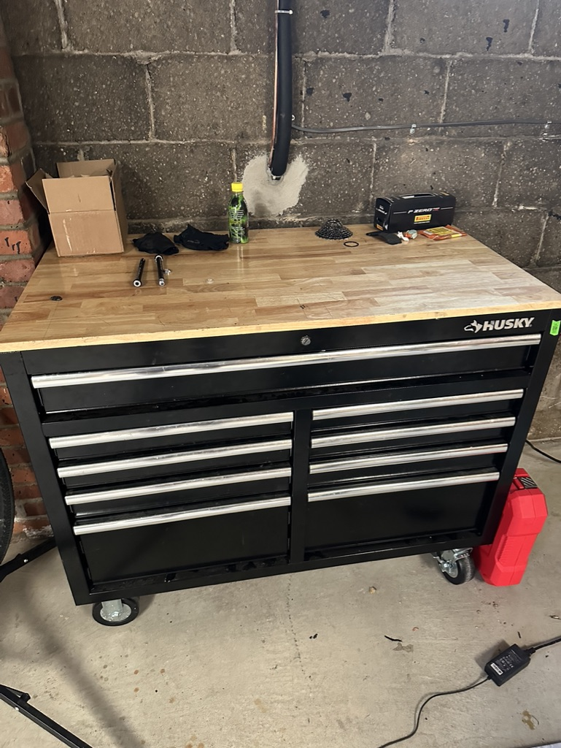
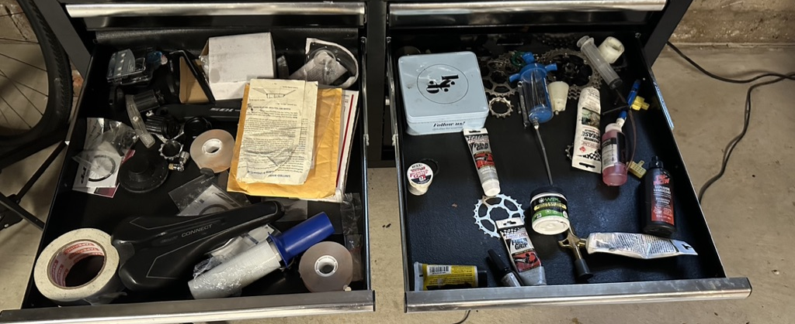
Before

Slide 8
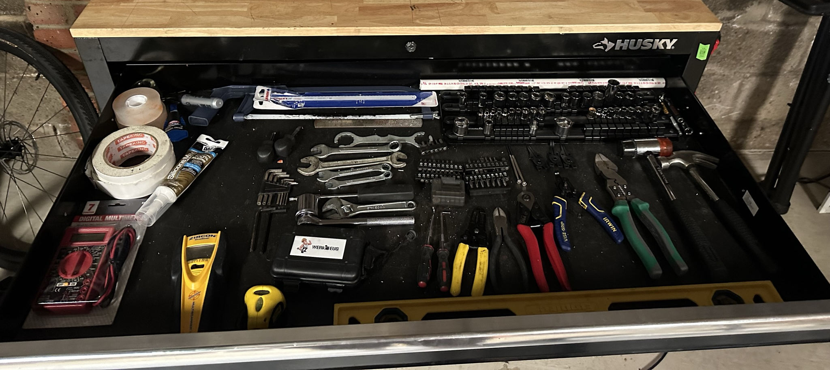
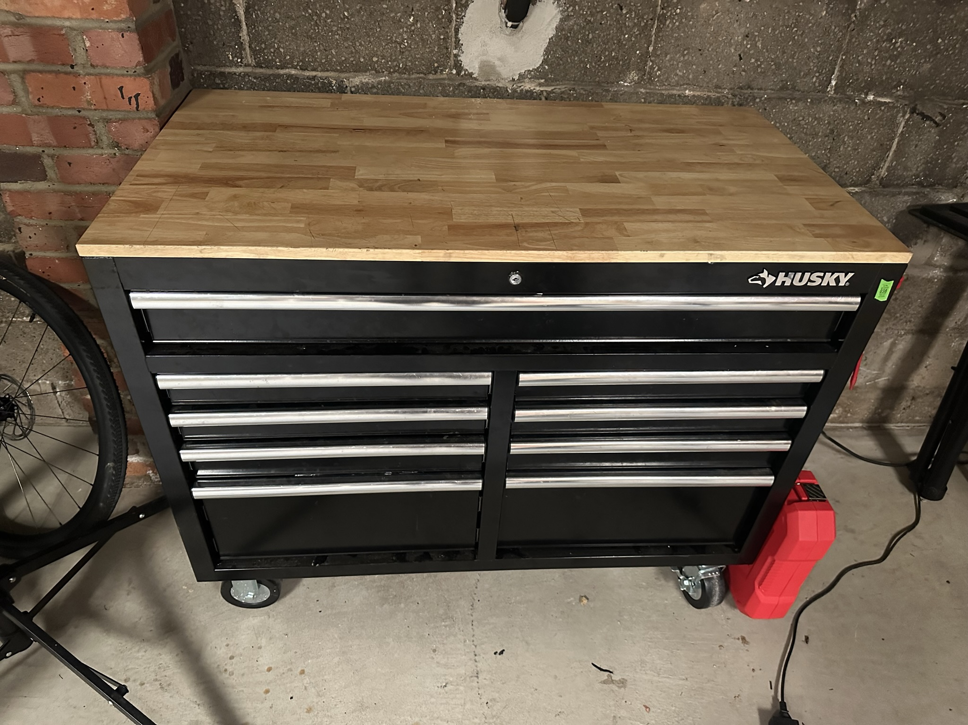
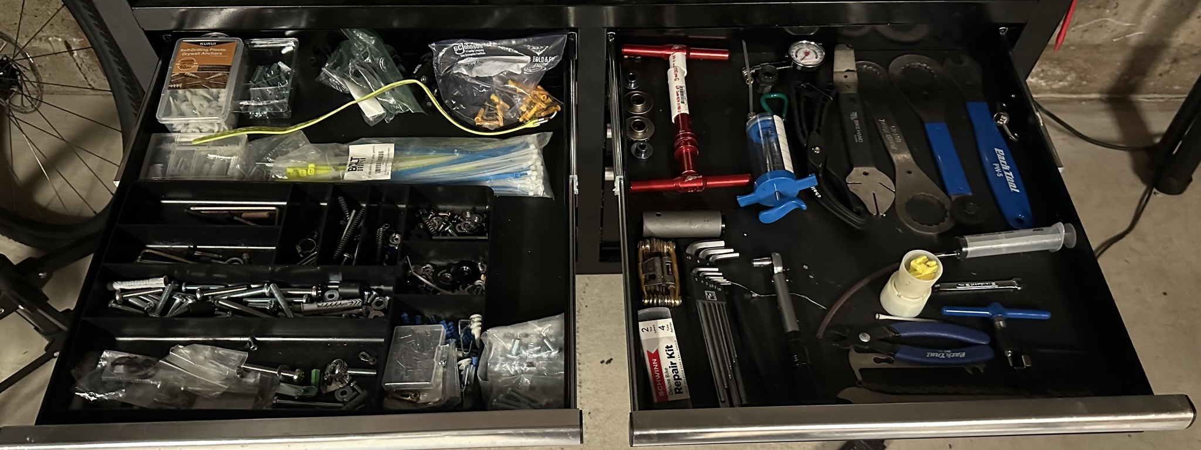
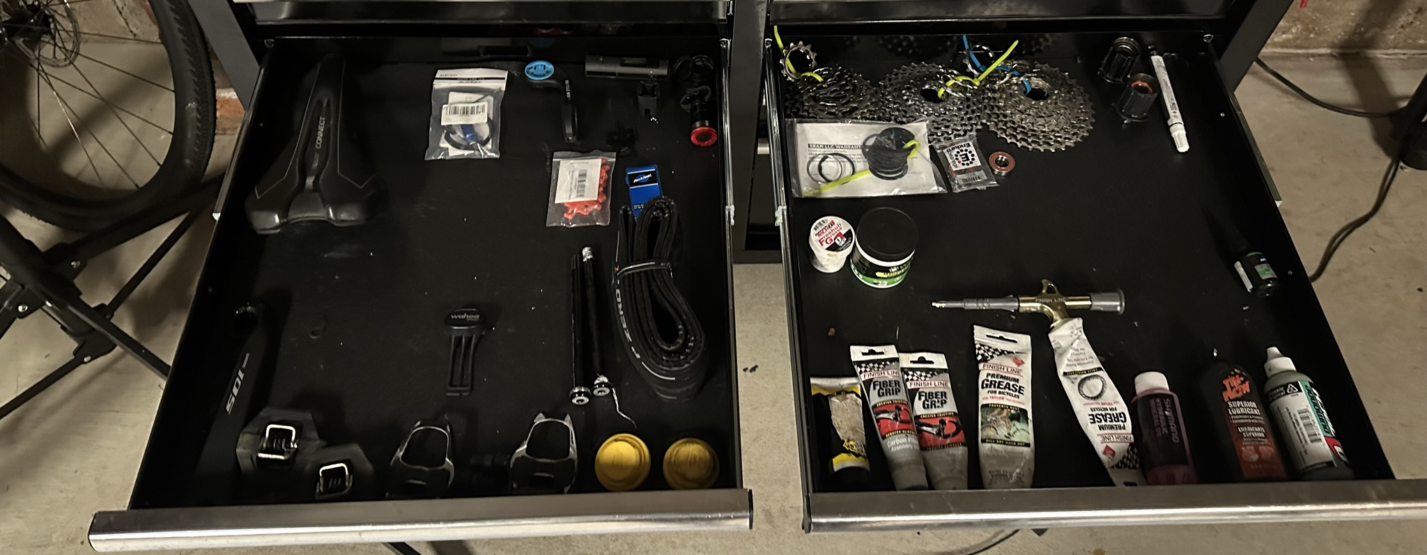
After
Adhesives
Twisting/Tightening
Hammering
Grip and Cut
Measuring
General Purpose Anchors
Bearings
Zip ties
Drivetrain
Tires
General Purpose Tools
General Purpose Spare Parts
Bike Tools
Brakes
General Purpose Screws
Bike Tightening
Bike Spare Parts
Bike Consumables
Framing
Chain Tools
Cockpit
Cassettes
Freehub
Saddle
Bearings
Wheel/Tires
Grease
Lubricants
Pedals

